Slide 1

Sentiment analysis on Social Media data

Slide 2
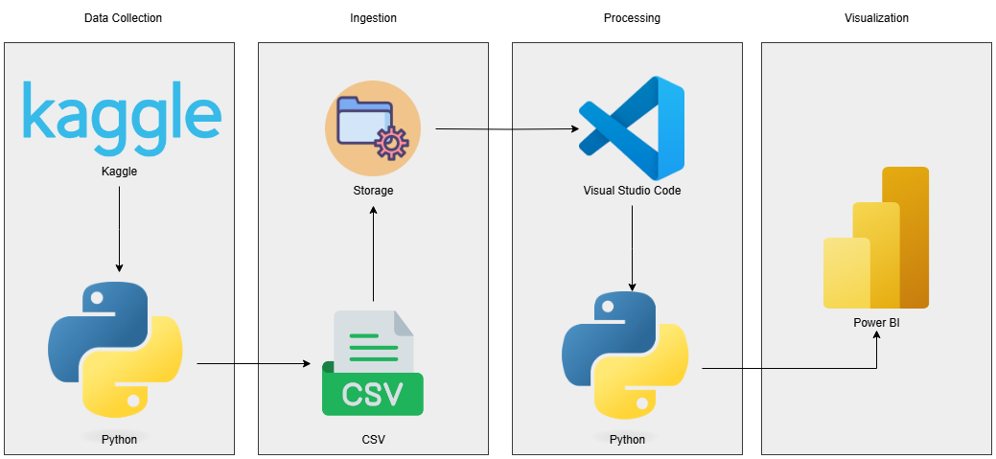
Architecture

Slide 3
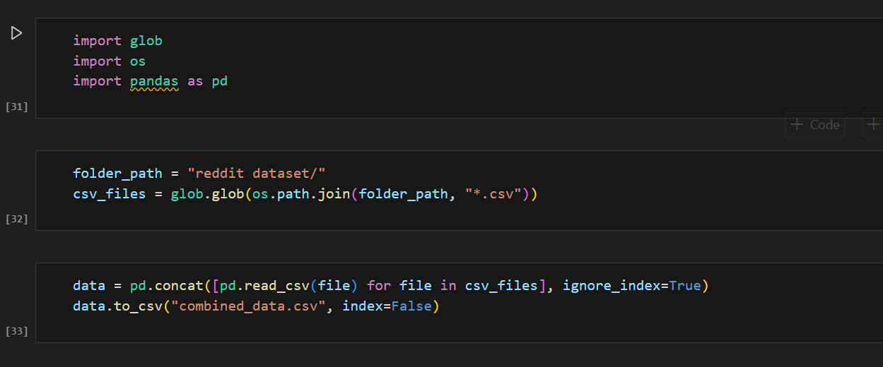
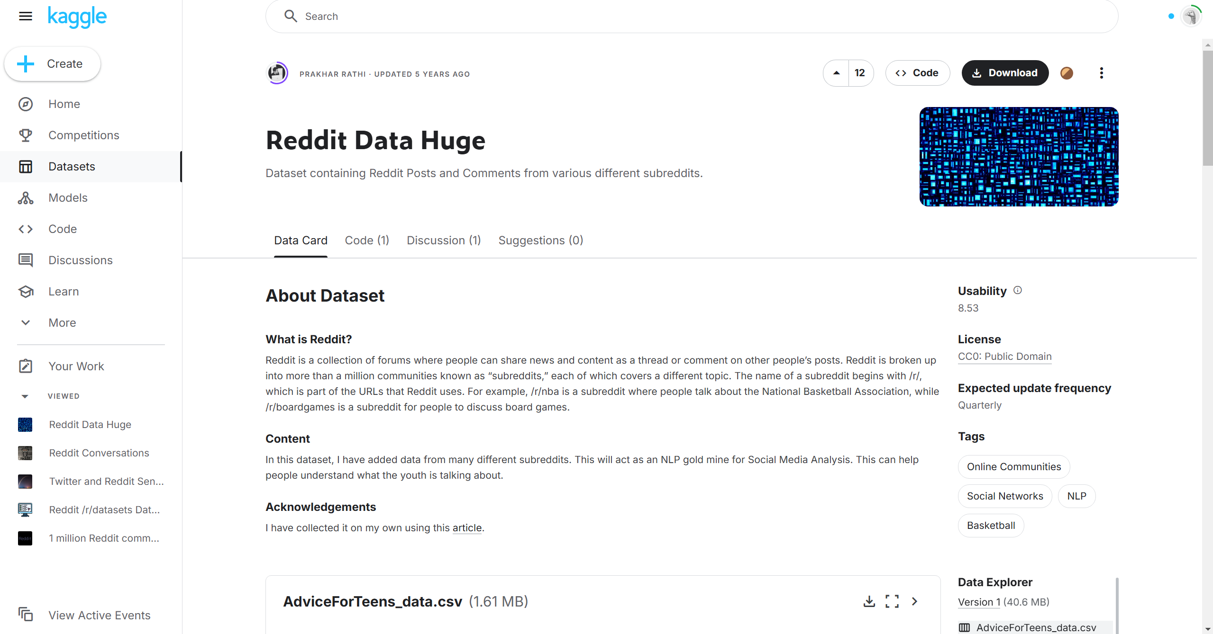
Data Source
We import data using python from Kaggle, It is reddit data with different subreddit texts and comments which we are going to analyze for deriving sentiments.

Slide 4
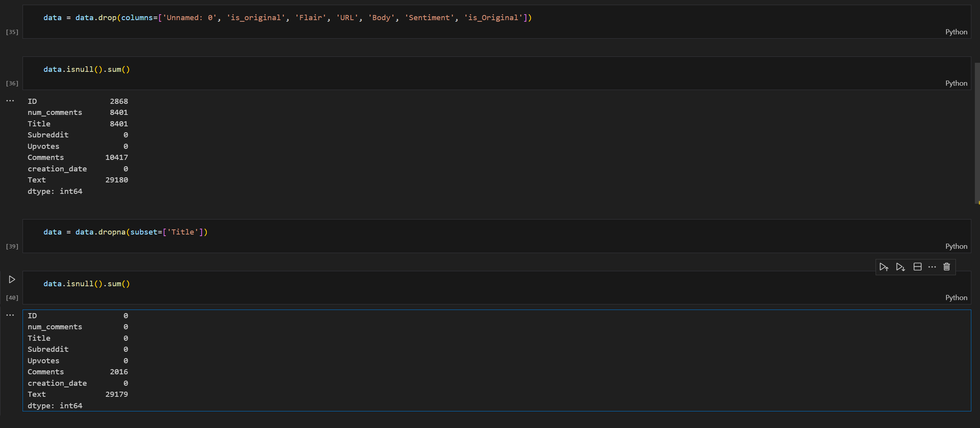
Data Processing
We imported and processed data using visual studio code and python where we cleaned data by removing unwanted columns and deleting null values.

Slide 5
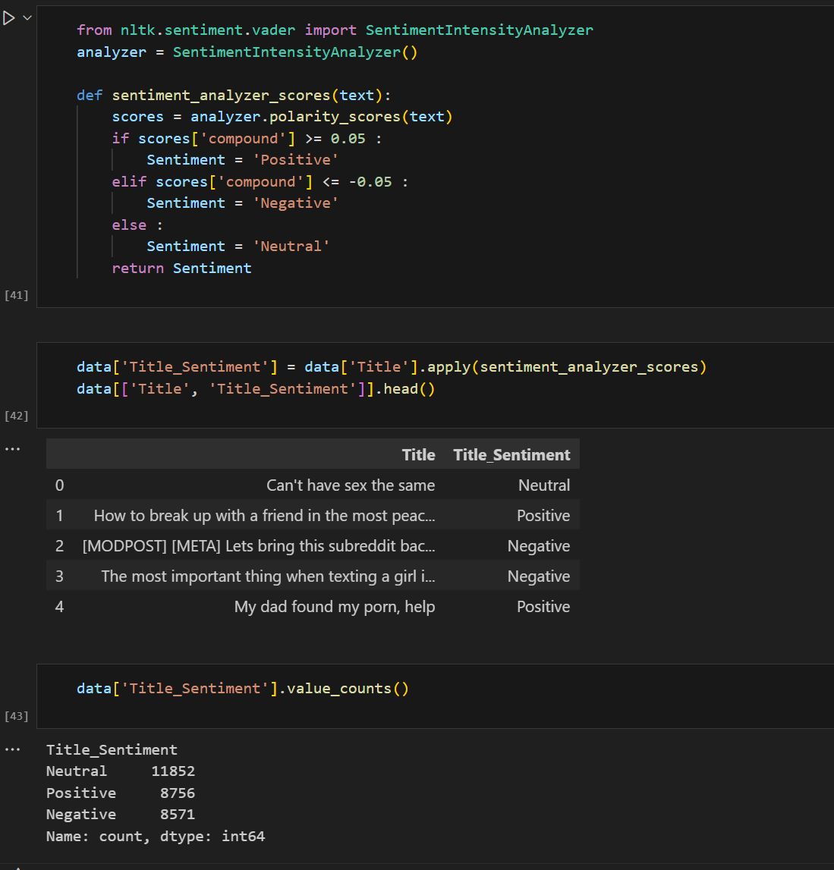
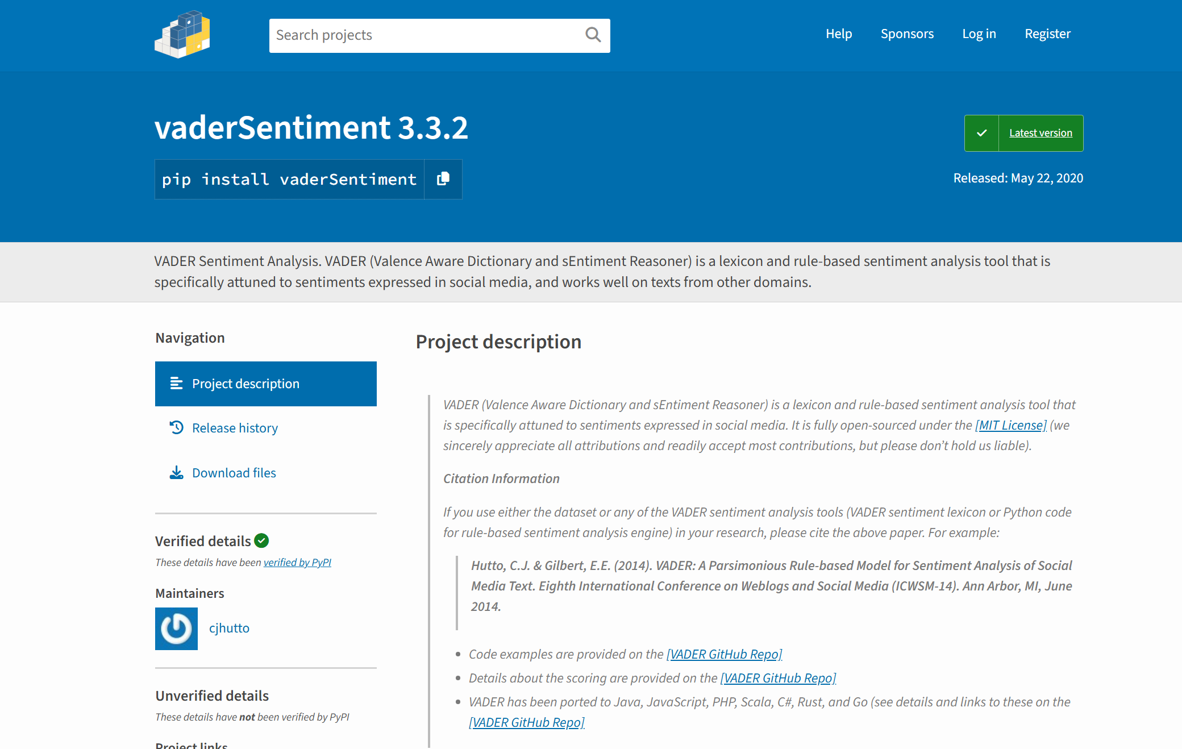
VADAR Sentiment Analysis
We are using VADAR algorithm for sentiment analysis we will import the library and process the Title column to get the sentiments of each text. Then we will add all the sentiments to a separate column so that we can visualize it.

Slide 6
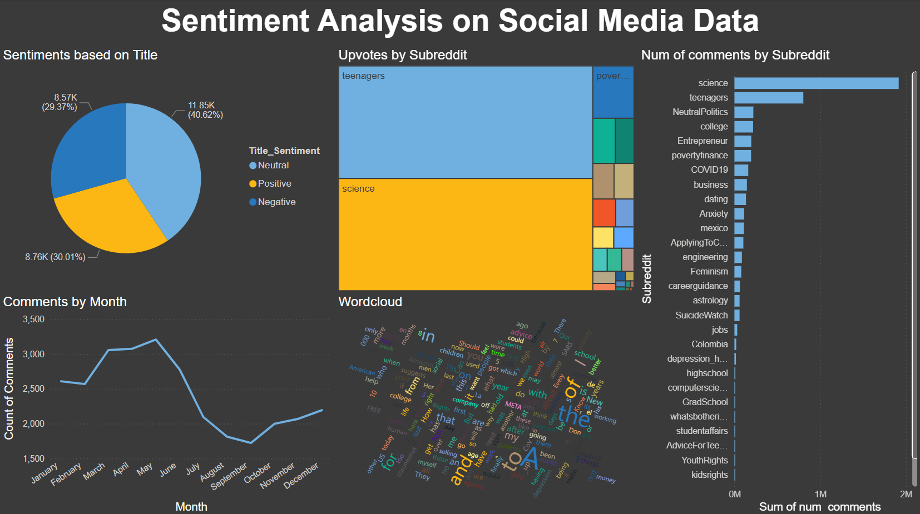
Data Visualization
We will be exporting the cleaned and analyzed data in csv format and transfer it in power bi to make dashboard.

Slide 7
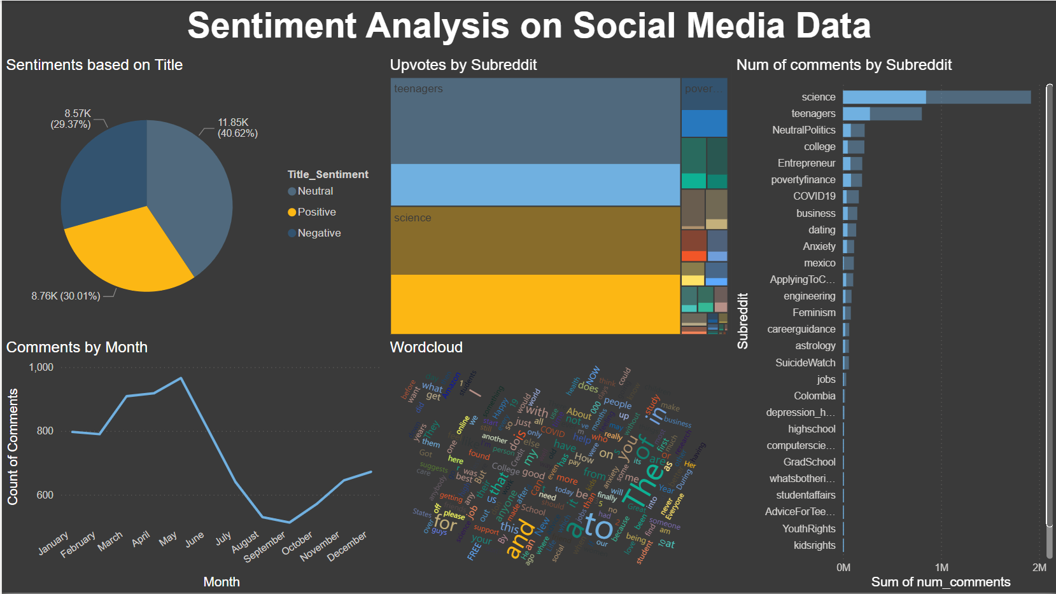
As we can see in the dashboard, we have created pie chart for the sentiments. As well as we created line graph for comments per month and bar chart for total comments per subreddit, also we have created word cloud with the greatest number of words used. And finally, a tree map for all the upvotes by subreddits.

Slide 8
Conclusion
So finally, we have analyzed and created dashboard on sentiments of social media data from reddit. In this assignment we collected the data from internet and processed it in python and we implemented VADAR algorithm, at last, we created dashboard using power bi. After analysis we get to know how to design architecture and implement every step.

Slide 9

Thank you

